Slide 1



Earned Value Management
LECTURE # 10

Slide 2
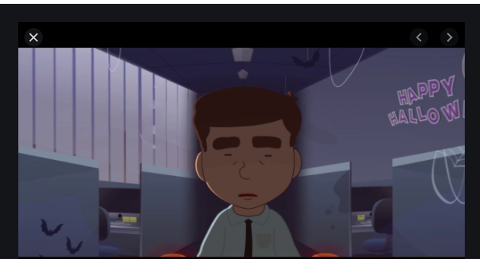
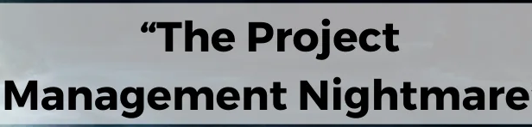
What are the POSSIBLE
NIGHTMARES for PM???

Slide 3
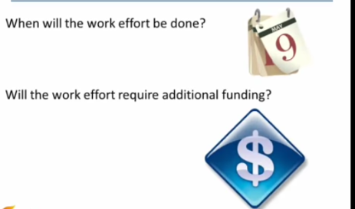
Leadership teams wants to know 2 simple questions:

Slide 4
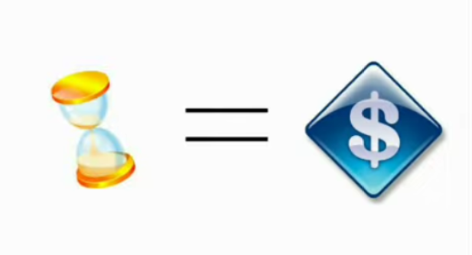


Slide 5

EARNED VALUE MANAGEMENT

Slide 6
EVM
EVM is a widely used scientific approach to measure, analyze and integrate project data to accurate report on current project status and also help us forecast the required performance.
It result from Earned value analysis indicating potential deviation from the project from cost or schedule base line.
CORE PROMISES:
How much will it cost?--- Promise!
How much did I get the work done?---Performance!
How much did it actually cost? ---Reality!

Slide 7
EVM helps….
When the initiative will be completed?
Amount of work actually accomplished
How well a project is performing in terms of schedule & cost?
Are we ahead or behind schedule? Are we over or under cost?
How efficient are we utilizing our resources?
Helps forecast how well a project will perform in future?
Will we be under or over budget in future?
If and when additional funding is required?
What questions should be ask to fix the project issues
Anticipate if action plans needs to be in place ( proactive than reactive

Slide 8
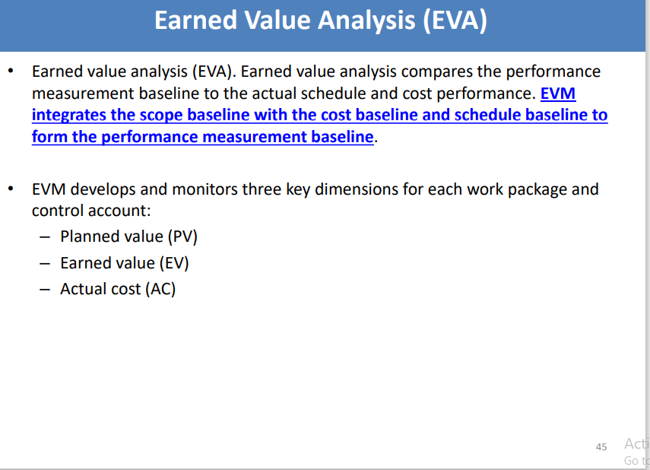
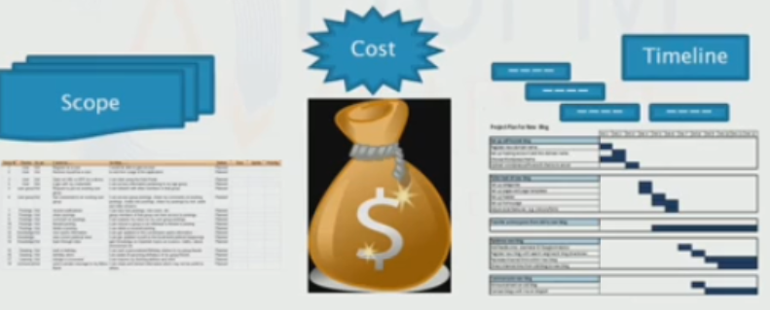
Earned Value Analysis
Earned value management: uses a set of formulas to help measure the progress of a project against the plan.
If the earned value management measures that are used for controlling project cost indicate significant variances from the budget, a re-estimation of the cost and schedule and a revisiting of the overall budget can be inevitable.
EVA BALANCING FACTOR:

Slide 9
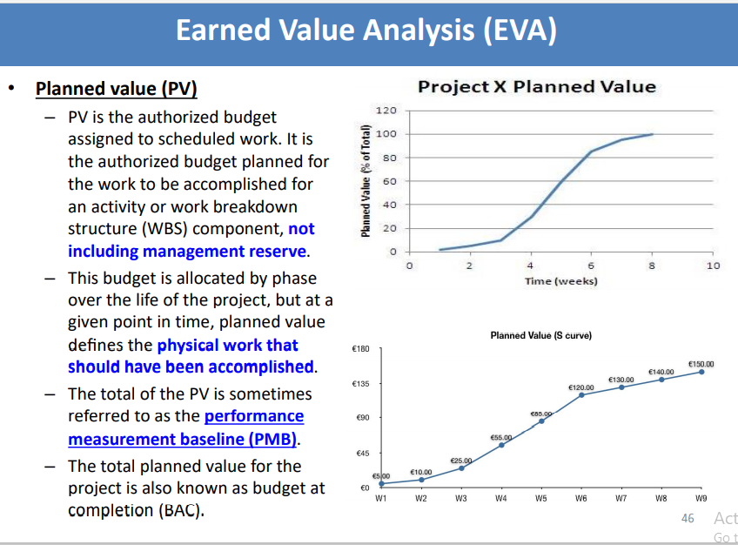
PLANNED VALUE

Slide 10
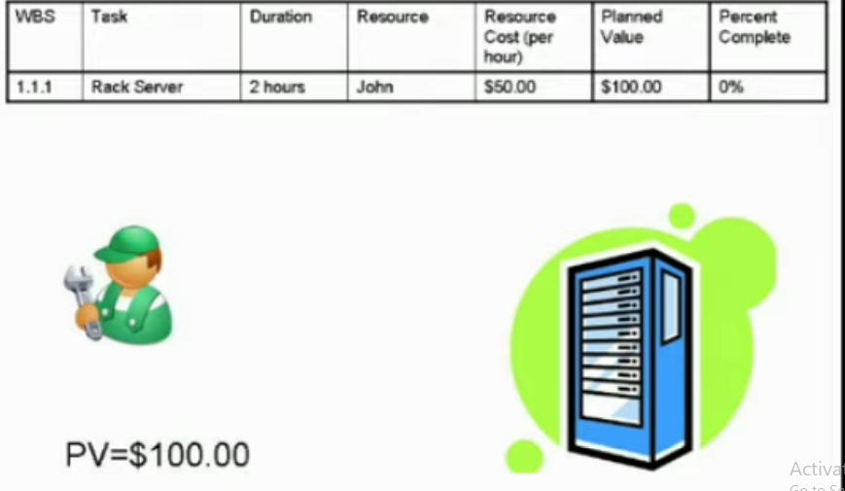
PLANNED VALUE (PV)

Slide 11
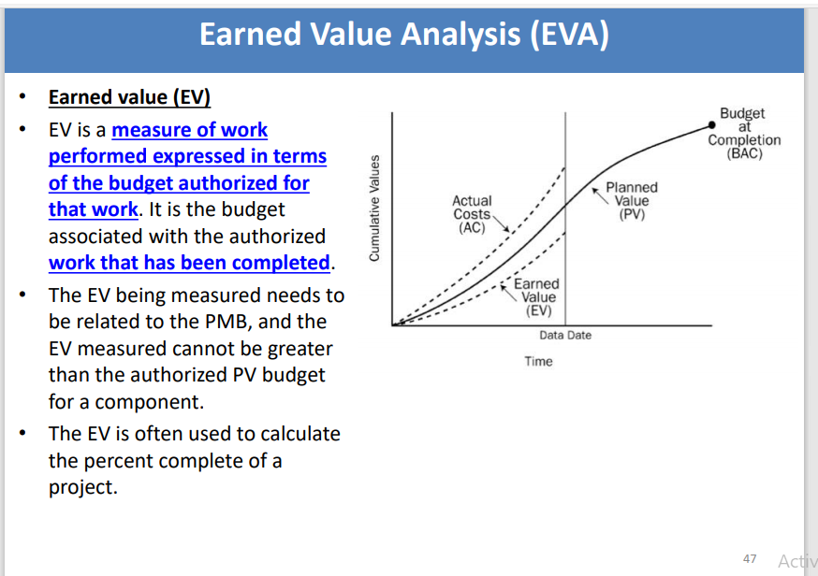
EARNED VALUE

Slide 12
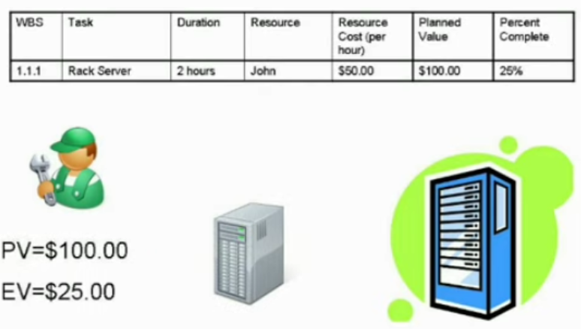
EARNED VALUE (EV)

Slide 13
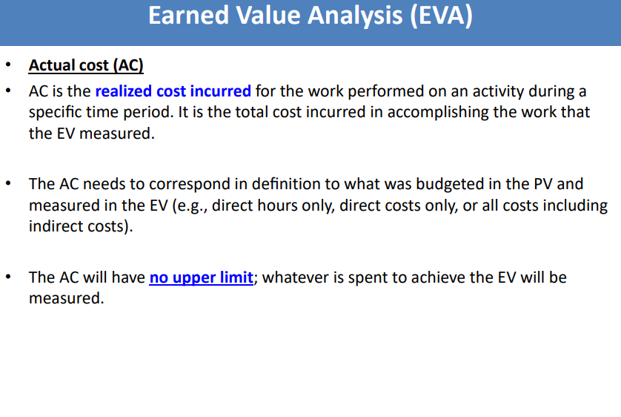
ACTUAL COST

Slide 14
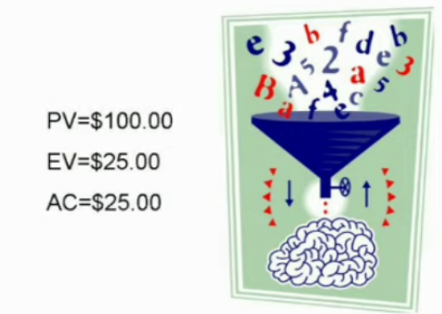
ACTUAL COST (AC)

Slide 15
TERMS TO KNOW
Acronym | Term | Interpretation
PV | Planned Value | As of today, what is the estimated value of the work planned to be done ?
EV | Earned Value | As of today what is the estimated value of the work actually accomplished
AC | Actual Cost | As of today, what is the actual cost incurred for the work accomplished?
BAC | Budget at Completion | How much did we budget for the total budget effort?
EAC | Estimate at complete | What do we currently expect the total budget to cost
ETC | Estimate to complete | From this point on how much do we expect it to cost to finish the project
VAC | Variance at completion | As of today how much over or under budget do we expect to be at the end of the project

Slide 16
BAC
Original Spending plan
PV
AC
Actual Spending
ETC
EAC
Forecast Spending Plan

Slide 17
FORMULAS
NAME | FORMULA | INTERPRETATION
PV | BAC x Planned % complete | Authorized budget assigned to the scheduled work
EV | BAC x actual % complete | Actual project value you have earned you have completed
AC | - | The actual amount you have spend on the project
Cost Variance (CV) | EV-AC | is over budget; + is under budget
Schedule Variance (SV) | EV-PV | is behind schedule; + is ahead of schedule
Cost Performance Index (CPI) | EV/AC | We are getting $_______worth of work out of every$1. Funds are or not efficiently used. Greater than 1 is good and less than 1 is bad.
Schedule Performance Index (SPI) | EV/PV | We are progressing at __% of the rate originally planned. Greater than 1 is good and less than 1 is bad.
Estimate at completion (EAC) | BAC/CPI | As of now how much do we expect the total budget to cost.
Estimate to completion (ETC) | EAC-AC | Total project cost as of today minus what has been spent to date
Variance at Completion (VAC) | BAC-EAC | How much over or under budget we will be at the end of project?

Slide 18

ACTIVITY
The project manager team meeting calls a team meeting and says,” We are six months into a million dollar project, and my latest analysis shows a CPI of 1.2 and SPI of 0.89. This means we are getting $ 1.2 for every dollar we put in project, but only progressing at 89% of the rate originally planned. Lets look for options.
a) Network specialist suggests she should be replaced by some less expensive member.
b) IT manager suggests either removing purchase of new computers from project or telling client it will be two weeks delayed.
c) Another team member suggests that
another programmer from IT department should
be called-in to get the activities done more quickly.

Slide 19
EXERCISE
You have a project to build a new fence. The fence will form a square. Each side will take 1 day to complete and 1000$ budgeted for each side. The sides are planned to be completed one after another. Today is end of Day 3
Activity | Day 1 | Day 2 | Day 3 | Day 4 | Status End of Day 3
SIDE 1 |  |  |  |  | Complete, spent $ 1000
SIDE 2 |  |  |  |  | Complete, Spent $ 1200
SIDE 3 |  |  |  |  | 50% done; spent $600
SIDE 4 |  |  |  |  | Not yet started

Slide 20
What is | Calculation | Answer | Interpretation of the answer
PV
EV
AC
BAC
CV
SV
CPI
SPI
EAC
ETC
VAC
We should have done $3000 worth of work
We should have completed $2500 worth of work
We should have actually spent $2800
Our project budget is $4000
We are over budget by $300
We are behind schedule
We are only getting about 89 cents out of every dollar we put into the project
We are only progressing at about 83% of the rate planned
We are currently estimated that the total project will cost
$ 4479
We need to spend additional $ 1679 to finish the project
We currently expect to be $ 479 over budget when project is complete

Slide 21
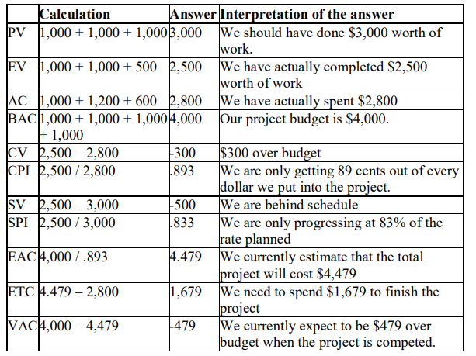

Slide 22
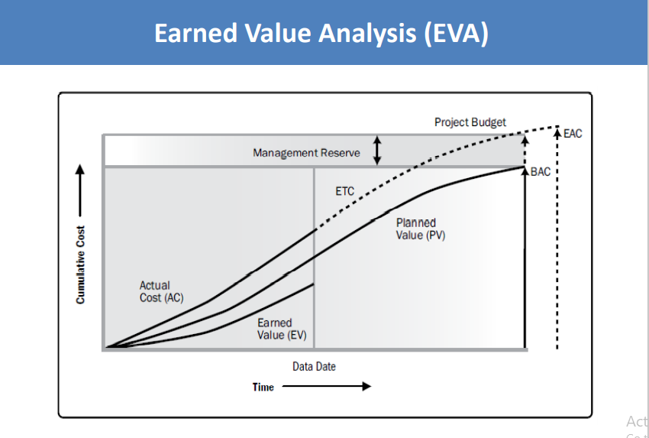

Slide 23
ACTIVITY
You are a project manager on a project that has $800,000 software development effort. There are two teams of programmers that will work for the six months for a total of 10,000 hours. According to the project schedule your team should be done with 38% of the work. As of today, the project is 40% complete while 50% of the project is consumed. Calculate and share your conclusions.

Slide 24
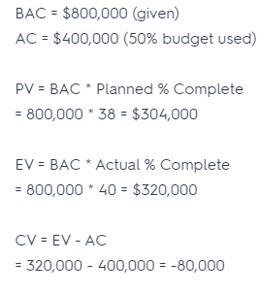
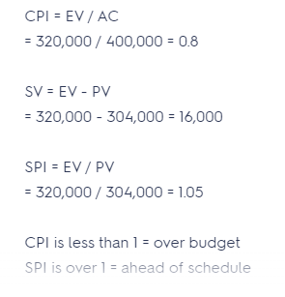

Slide 25

Conclusions
THANK YOU

